Slide 1
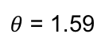
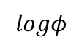
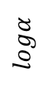
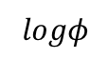
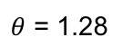
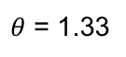
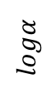
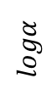
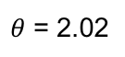
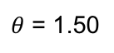
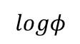
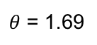
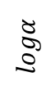
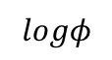
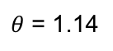
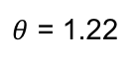
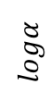
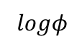
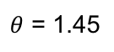
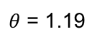
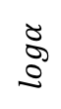
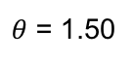
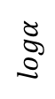
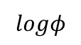
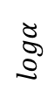
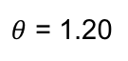
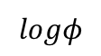
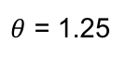
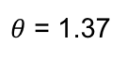
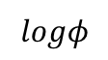
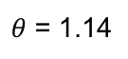
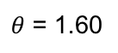
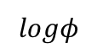
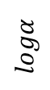
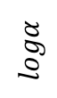
arthritis
colorectal cancer
Crohn’s disease
liver cirrhosis
obesity
type 2 diabetes
ulcerative colitis
$θ$ = 1.14
$θ$ = 1.69
$θ$ = 1.19
$θ$ = 1.20
$θ$ = 1.28
$θ$ = 1.33
$θ$ = 1.14
$$logα$$
$$logα$$
$$logα$$
$$logα$$
$$logα$$
$$logα$$
no arthritis
control
control
control
control
control
control
$$logφ$$
$$logφ$$
$$logφ$$
$$logφ$$
$$logφ$$
$$logφ$$
$θ$ = 1.50
$θ$ = 1.60
$θ$ = 2.02
$θ$ = 1.45
$θ$ = 1.25
$θ$ = 1.37
$θ$ = 1.50
$$logα$$
$$logα$$
$$logα$$
$$logα$$
$$logα$$
$$logα$$
moderate arthritis
carcinoma
disease
disease
disease
disease
disease
$$logφ$$
$$logφ$$
$$logφ$$
$$logφ$$
$$logφ$$
$$logφ$$
$θ$ = 1.22
$θ$ = 1.59
$$logα$$
$$logα$$
high arthritis
advanced adenoma
$$logφ$$
$$logφ$$

Slide 2
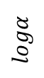
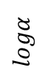
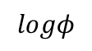
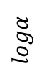
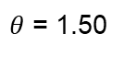
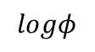
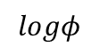
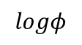
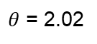
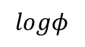
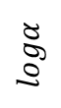
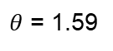
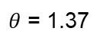
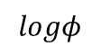
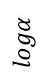









arthritis
colorectal cancer
Crohn’s disease
liver cirrhosis
obesity
type 2 diabetes
ulcerative colitis
$θ$ = 1.50
$θ$ = 1.60
$θ$ = 2.02
$θ$ = 1.45
$θ$ = 1.25
$θ$ = 1.37
$θ$ = 1.50
$$logα$$
$$logα$$
$$logα$$
$$logα$$
$$logα$$
$$logα$$
moderate arthritis
carcinoma
disease
disease
disease
disease
disease
$$logφ$$
$$logφ$$
$$logφ$$
$$logφ$$
$$logφ$$
$$logφ$$
$θ$ = 1.22
$θ$ = 1.59
$$logα$$
$$logα$$
high arthritis
advanced adenoma
$$logφ$$
$$logφ$$

Slide 3

















arthritis
colorectal cancer
Crohn’s disease
liver cirrhosis
obesity
type 2 diabetes
ulcerative colitis
$χ$ in moderate
arthritis group
$χ$ in carcinoma group
$χ$ in disease group
$χ$ in disease group
$χ$ in disease group
$χ$ in disease group
$χ$ in disease group
$χ$ in control group
$χ$ in control group
$χ$ in control group
$χ$ in control group
$χ$ in control group
$χ$ in control group
$χ$ in control group
$χ$ in high
arthritis group
$χ$ in advanced
adenoma group
$χ$ in control group
$χ$ in control group

Slide 4

AMR genes’
prevalence
AMR genes’
abundance
AMR genes’
$χ$ values
carcinoma
obesity
high arthritis
liver cirrhosis
Crohn’s disease
type 2 diabetes
moderate arthritis
advance adenoma
ulcerative colitis

